Slide 1
Deep Learning-Based Interruption Discovery Framework for Software-Defined Networks
Authors:
Dr. Vikas Mahandule, Mrs. Harsha Patil, Mr.Saurav Temgire, Mr. Aniket Masale,
Mr. Sarvadnya Mawal, Mr. Prince Turkar
HOD, Assistant Professor, Department of Computer Application
Assistant Professor, Department of Computer Application2
Students, MSC(CA)3,4,5,6
MIT Arts Commerce and Science College Alandi Devachi, Pune, Maharashtra, India

Slide 2
Introduction to Deep Learning in SDNs
Software-defined networks (SDNs) are complex and dynamic, making it difficult to detect and fix network problems (outages).
Traditional methods for finding these problems often don't work well because SDNs are so large and unpredictable.
Our research uses deep learning, a powerful technology, to find these network problems more effectively.

Slide 3

Abstract of the Research
The research focuses on enhancing interruption detection in SDNs through advanced deep learning techniques.
Traditional interruption detection methods struggle with the complexity of SDNs
Our approach leverages both CNNs and RNNs to analyze network traffic data
Captures temporal and geographical relationships for improved detection accuracy

Slide 4
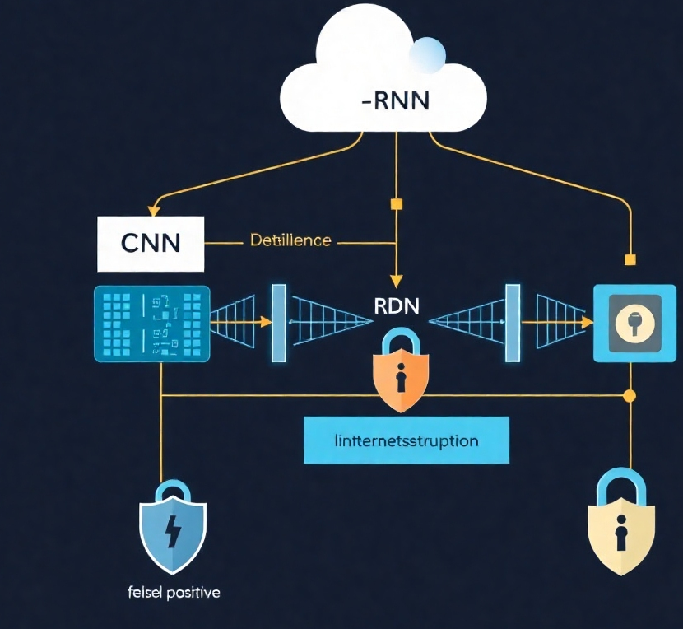
Significance of the Research
This research presents a novel approach that combines CNNs and RNNs, significantly impacting the performance of interruption detection.
Improved detection accuracy leads to reduced false positives
Enhances the resilience of SDN management systems
Contributes to the overall security and stability of network operations

Slide 5

Identifying the Research Problem
Traditional interruption detection techniques are inadequate for managing the scale and unpredictability of SDNs.
Difficulty in identifying and mitigating network outages
Poor performance and increased downtime with existing methods
Need for a more efficient and effective detection approach

Slide 6
Methodology Overview
Data Collection: Gather network traffic data from real-world SDN setups.
Data Preprocessing: Clean, normalize, and extract relevant features from the raw data.
Model Development: Create and refine deep learning models (CNNs and RNNs).
Model Training and Validation: Train the models using the processed data and validate their performance.
Integration and Implementation: Integrate the trained models into the SDN environment for real-time detection.

Slide 7

Deep Learning Models Used
The research employs specific deep learning models to enhance detection capabilities.
CNNs: Focus on analyzing spatial patterns and are excellent for feature extraction
RNNs: Capture temporal dependencies and identify recurrent traffic irregularities
CNN-RNN Integration: Combines both analyses for higher detection accuracy

Slide 8
Challenges Faced and Solutions Proposed
Key Challenges
Our Solution
SDNs are vulnerable to cyberattacks due to their centralized control.
Traditional methods often fail to keep up with the dynamic nature of modern SDN setups.
There is a need for more effective methods to detect interruptions in SDNs.
We use Deep Neural Networks (DNNs), a type of artificial intelligence that can learn from vast amounts of data.
DNNs can analyze network traffic patterns and identify anomalies that indicate disruptions or invasions.
This approach helps to improve the accuracy and efficiency of detecting problems in SDNs.

Slide 9

Results and Discussion
Key findings from the research highlight the effectiveness of the proposed framework.
Significant improvements in detection accuracy
Enhanced implications for SDN management and security
Validation of the effectiveness of deep learning approaches in real-world scenarios

Slide 10

Future Scope of Research
The research opens avenues for potential future developments in SDNs.
Exploration of additional deep learning techniques for enhanced detection
Application of the framework in different network environments
Continued research on improving data quality and model integration

Slide 11
Conclusion
The research contributes significantly to interruption detection in SDNs through a deep learning approach.
Highlights the effectiveness of combining CNNs and RNNs
Addresses the inadequacies of traditional detection methods
Provides a foundation for future advancements in SDN management systems
Deep learning is a powerful tool for enhancing network security.
Our framework effectively detects interruptions in SDNs.
Future research should focus on optimizing and deploying this technoloy

Slide 12
References
[1]. Kreutz, D., Ramos, F. M., & Veríssimo, P. (2015). "Software-Defined Networking: A ComprehensiveSurvey." Proceedings of the IEEE, 103(1), 14-76.
[2]. Tang, J., Yang, X., & Zhao, L. (2020). "Deep Learning for Anomaly Detection in Network Traffic." Journal of
Computer Networks and Communications, 2020, Article ID 5437584.
[3]. Yin, S., Li, C., & Zhang, H. (2021). "Intrusion Detection System Using Long Short-Term Memory Networks."IEEE Access, 9, 27911-27921.
[4]. Zhang, L., & Zhao, X. (2019). "A Survey on Privacy-Preserving Techniques in Machine Learning." IEEETransactions on Knowledge and Data Engineering, 31(7), 1245-1258.
[5]. Jaffrelot, C. (2009). The Hindu Nationalist Movement and Indian Politics: 1925 to the 1990s. PrincetonUniversity Press.

